Slide 1
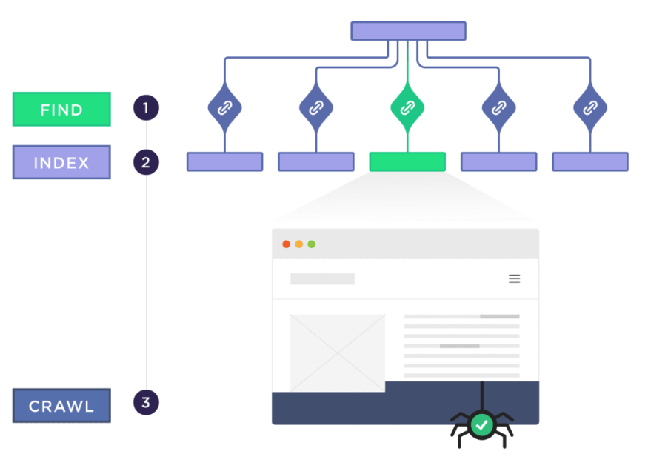
Technical seo
Sahar andaleeb
Week # 05-06
TECHNICAL SEO
By: Sahar Andaleeb

Slide 2
What Is Website Architecture?
“Website Architecture is how a website’s pages are structured and linked together.”
Why Is Website Architecture Important for SEO?
An optimized site architecture helps search engine spiders find and index all of the pages on your website.
The right website architecture makes it easy for visitors to find what they need on your site.
Homework (Important): Explore different website architecture and analyse which one or which combination suits you.
https://youtu.be/BXaXmDsZqZo?si=AHm5MxOFYCP29CKU

Slide 3
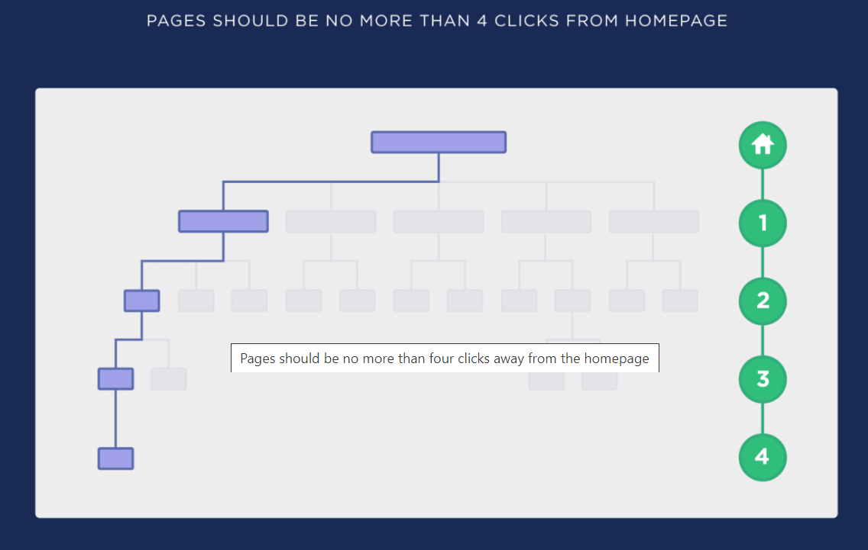
Flat architecture levels
Use a “Flat” Site Architecture
Ideally 4 clicks or less.

Slide 4
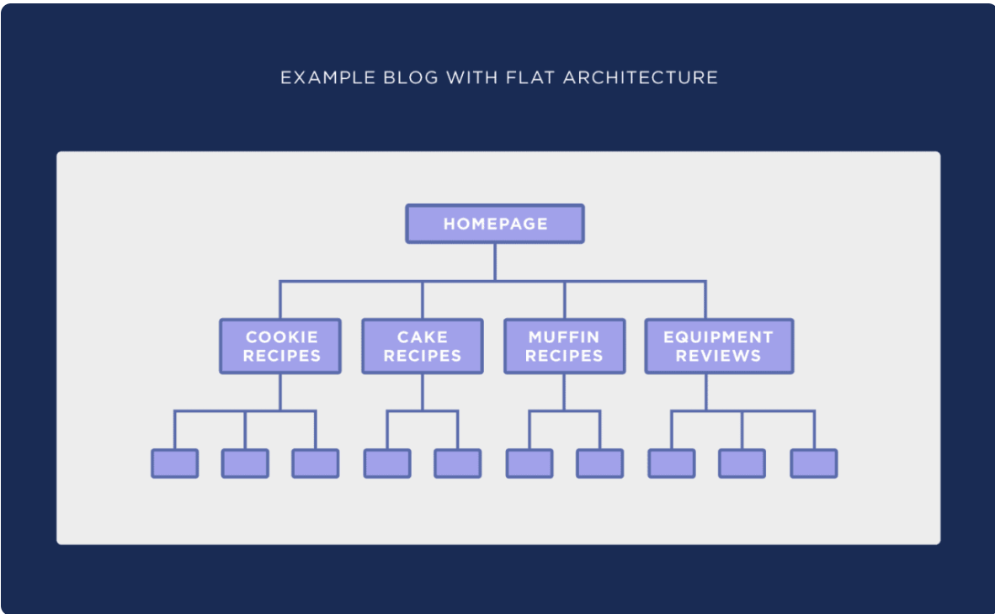
Flat architecture

Slide 5
SEO-Friendly Website Architecture:
“A structure designed to enhance the visibility of a website on search engine results pages (SERPs) by optimizing its organization, navigation, and content.”
It focuses on improving user experience, accessibility, and crawlability for search engine bots.

Slide 6
Types of SEO-Friendly Website Architecture:
Flat Architecture: Shallow hierarchy with minimal levels of navigation. All pages are easily accessible from the homepage.
Hierarchical Architecture: Organized in a tree-like structure, with categories and subcategories, facilitating easy navigation.
Silo Architecture: Content grouped into thematic silos or categories, enhancing topical relevance and keyword focus.

Slide 7
Important Concepts
Silo Structure:
Organizing content into distinct silos based on topics or themes.
Helps search engines understand the topical relevance of content and boosts keyword targeting.
Topical Authority:
Demonstrates expertise and authority on specific topics or niches.
Achieved by consistently publishing high-quality, relevant content and earning backlinks from authoritative sources.
Content Hub:
Centralized repository for comprehensive and authoritative content on a specific topic.
Serves as a go-to resource for users and enhances topical relevance and authority.
Often includes pillar pages, comprehensive guides, and related content to cover all aspects of the topic.

Slide 8
… cont.
Link Equity: (a.k.a link juice)
The value or authority passed from one webpage to another through hyperlinks(backlinks).
Higher-quality and relevant links typically contribute more link equity to the receiving page, potentially improving its search engine ranking.
Page Authority:
A metric that predicts how well a specific webpage is likely to rank on search engine result pages (SERPs).
Influenced by factors like the quality and quantity of inbound links, content relevance, and overall website authority.

Slide 9
Site map
“A sitemap is a file that lists all the pages of a website, providing search engines with structured information about the site's content.”
Search engines read this file to crawl your site more efficiently
A sitemap can have a maximum of 50,000 links. Google will not crawl more than it.
If there are more than 50,000 URLs on a website, then multiple sitemaps will need to be created.

Slide 10
Importance of Sitemaps in SEO
Improved Crawling: Sitemaps help search engine bots discover and index all pages of a website more efficiently.
Enhanced Visibility: They ensure that search engines can access and understand the content hierarchy and importance.
Faster Indexing: With a sitemap, new or updated content can be indexed quicker by search engines.
Two types:
Xml-site maps and html-site maps

Slide 11
XML Sitemap
“XML Sitemap is a structured file in XML format that lists the important URLs of a website along with additional metadata such as the last modified date, change frequency, and priority level of each URL.”
XML sitemaps are primarily designed for search engines to efficiently crawl and index website content.
helps search engine bots understand the website's structure, leading to better visibility and ranking in search engine results.
Tools:
https://www.xml-sitemaps.com/
Screaming frog

Slide 12
Xml Sitemap Syntax
Xml Sitemap Syntax:
<url>
<loc>https://www.example.com/page1.html</loc> <lastmod>2024-10-11</lastmod> <changefreq>monthly</changefreq> <priority>0.8</priority>
</url>
<loc> specifies the URL of the page.
<lastmod> indicates the last modification date of the page.
<changefreq> suggests how frequently the page is likely to change.
<priority> indicates the priority of this URL relative to other URLs on your site.

Slide 13
Html sitemap
Html sitemap is a webpage on a website that serves as a navigational aid for visitors by providing a hierarchical list of links to all the pages within the site.
Unlike XML sitemaps, which are intended for search engines, HTML sitemaps are created for human users.
provides a visual representation of the website's structure and interlinking between pages

Slide 14
Robots.txt
Robots.txt: “A text file located in the root directory of a website that instructs search engine crawlers on how to interact with the site's pages.”
Robots.txt can prevent certain pages from being indexed
useful for keeping sensitive information private.
User information, bank details etc.
IMPORTANCE:
Page Priority: Prioritize crawling of important pages by allowing crawlers to focus on them rather than less important pages.
Resource Efficiency: Prevents crawlers from wasting resources on non-essential pages, improving overall crawl efficiency.
Avoiding Penalties: Properly configured robots.txt can prevent search engines from indexing content that could lead to SEO penalties, such as duplicate content or thin content.

Slide 15
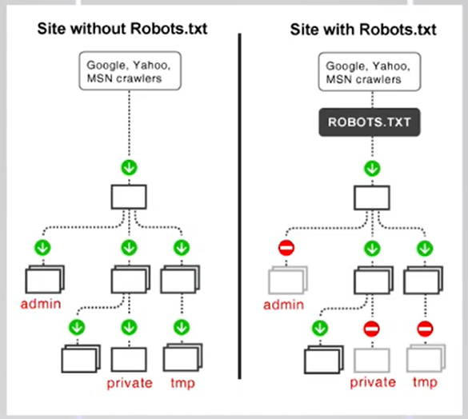
Robots.txt example

Slide 16
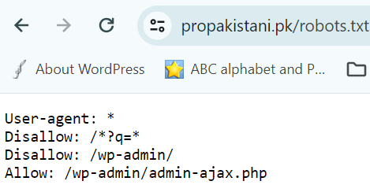
Robots.txt syntax
Syntax:
Use "User-agent" to specify which crawler the rule applies to.
*
"Disallow" directive to specify which URLs should not be crawled/indexed.
"Allow" directive to override a previous disallow rule.
Also include "Sitemap" directive to indicate the location of the website's XML sitemap.

Slide 17
Robots.txt .. Cont.
Common Mistakes:
Blocking essential pages inadvertently.
Allowing crawlers to access sensitive or private information.
Keep your hosting safe… (it contains robots.txt..harmful manipulation in it can harm your SEO completely)

Slide 18
Canonical issue
Canonical issue: “A canonical issue in SEO refers to problems that arise from having multiple URLs that point to the same content within a website.”
This issue can dilute the site's search engine rankings
http://propakistani.com
https://propakistani.com
https.://www. propakistani.com
https://propakistani.com
propakistani.com
WWW vs. Non-WWW and HTTP vs. HTTPS, filters

Slide 19
Canonical issue effect on seo
This issue can dilute the site's search engine rankings
Duplicate Content: Search engines may crawl and index multiple versions of the same content, seeing them as separate and duplicate pages
Split Page Authority: Backlinks might point to multiple versions of the same content, splitting the authority (or link equity) among those versions instead of consolidating it to a single page.
Wasted Crawl Budget: Multiple versions of the same content can lead to inefficient use of crawl budget, as the bot spends time crawling duplicate content instead of discovering new or updated content.

Slide 20
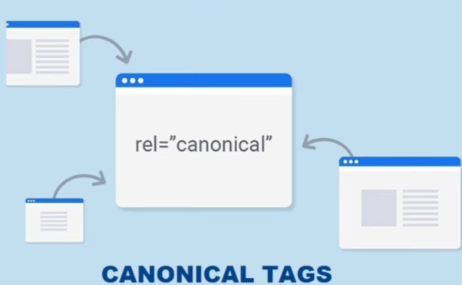
Canonical tag
Canonical Tag:
“A canonical tag is an HTML element that helps website administrators to prevent duplicate content issues by specifying the "canonical" or "preferred" version of a web page.
Purpose:
Helps search engines understand which version of a page to index and present in search results.
Prevents split ranking signals for pages with similar or duplicate content.

Slide 21
Canonical tag syntax
Placed in the <head> section of an HTML document.
<link rel="canonical" href="URL-of-the-preferred-page"/>
Example:
<link rel="canonical" href="https://propakistani.pk/" />

Slide 22
Broken links
Reasons of broken links:
Updated URL
Change in URL without Redirections
Deleted web pages
Content/ post deleted
Misspelled URL
The first step is to find the broken links, if any
Tools:
→ https://brokenlinkcheck.com/
→ Google Search Console

Slide 23
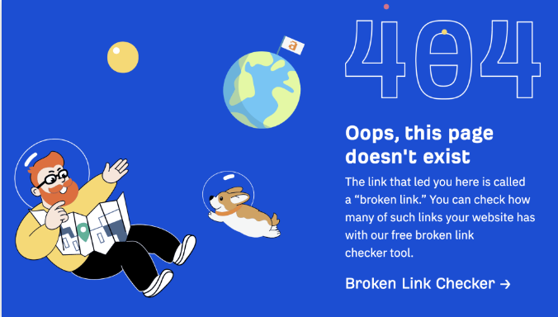
404 error page
“An HTTP error 404 occurs when the web server cannot find a resource (like a webpage) at a certain URL.”
404 error page is a response to missing links
Add it in your website
A well-designed 404 page can encourage users to explore other parts of your site instead of leaving immediately after encountering an error.

Slide 24
What is a redirect?
A redirect is a way to send both users and search engines to a different URL from the one they originally requested.
Most commonly used redirects are 301 & 302
301 redirect: It's a permanent redirect.
It tells search engines that the original URL has been permanently moved to a new location.
302 redirect: It's a temporary redirect.
It indicates that the original URL has been temporarily moved to a new location.

Slide 25
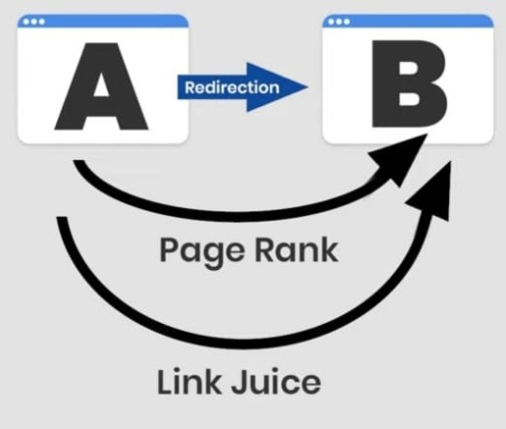
301 & 302 redirects
When to apply 301 redirection:
Webpage/ website changed
Domain name changed (TLD changed)
Ownership changed
http to https
When to apply 302 redirection:
Page is updating / under maintenance
Content is not ready
X

Slide 26
Schema markup
Schema markup (schema.org) is a structured data vocabulary that helps search engines to understand your website content better.
Enhances search results: It can result in rich snippets or enhanced search results.
Structured data: It provides a structured format for search engines to understand the content, improving relevance and visibility.
Types: Includes various types like product, recipe, event, organization, bread crumbs etc.
SEO benefit: Can lead to higher click-through rates and improved rankings by providing more relevant information to users.

Slide 27
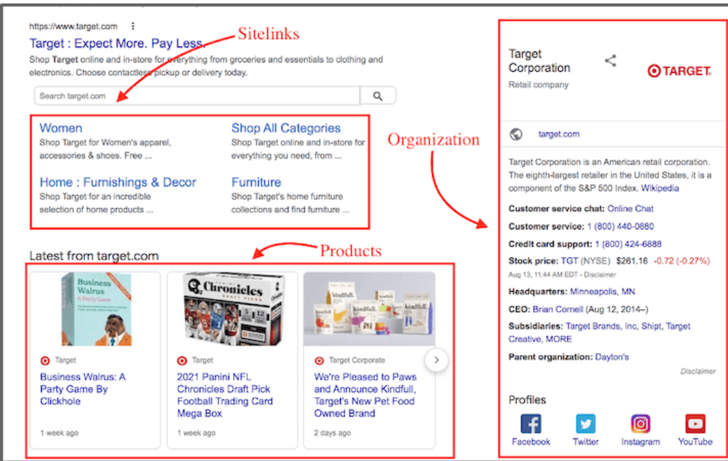
Adding schema
Schema markup generator Tools:
https://technicalseo.com/tools/schema-markup-generator/

Slide 28
Dwell time & bounce rate
Dwell time: Measures the duration visitors spend on a website or webpage before returning to search results or navigating away.
Higher dwell time indicates engaging content and user satisfaction, which can positively impact SEO rankings.
Bounce rate: Indicates the percentage of visitors who navigate away from a website after viewing only one page.
A lower bounce rate suggests that visitors are finding relevant information or engaging content, which can also positively affect SEO.

Slide 29
How to decrease bounce rate
Ensure that your meta title matches the content
Improve content readability
Enhance website UI
Avoid too many ads
Add images and media on the page
Work on improving website speed
Use internal linking in a strategic way
Make sure there are no technical glitches

Slide 30
Good bounce rate
What bounce rate is good in SEO?
A good bounce rate varies on the niche of the website and the type of page.
On average, the bounce rate should be between 40% to 50%.
eCommerce sites: 20% to 45%
Content-based sites and blogs: 35% to 60%
Landing pages: 60% to 90%
Web portals, news sites, event sites, and dictionaries: 65% to 90%
B2B sites: 25% to 55%
In general, you can categorize the bounce rate as follows:
Poor: 70% or more
Average: 55% to 70%
Good: 41% to 70%
Excellent: 25% to 40%

Slide 31
Page speed optimization
Page speed optimization is vital for SEO as it boosts user experience, search rankings, and conversions
User Experience: Faster pages enhance user satisfaction, reducing bounce rates and increasing engagement.
Search Rankings: Google considers page speed a ranking factor, impacting visibility.
Mobile Performance: Quick-loading sites are crucial for mobile users, who expect speed.
Conversions: Faster sites lead to higher conversion rates, as users prefer seamless experiences.
Crawl Efficiency: Slow pages can hinder search engine crawlers, affecting indexing.
Competitive Edge: A slight speed advantage can differentiate your site from competitors.

Slide 32
Tools to analyze Page Speed
These tools give a performance score from 0 to 100. The higher the number, the better.
Google’s PageSpeed Insights
Gtmetrix
Chrome User Experience Report
Search Console (Core web vital report)
Web-vitals JavaScript Library
LightHouse
Chrome Dev Tools

Slide 33
Web Vitals?
“Web Vitals are a set of standardized metrics from Google that help developers understand how users experience a web page.”
Web Core Vitals optimization can improve a website's performance in search results, as Google prioritizes sites that offer a better user experience.
Important metrics to measure:
Core Web Vitals (LCP, INP, CLS)

Slide 34
Core Web Vitals?
“Core Web Vitals are the subset of Web Vitals.”
Each of the Core Web Vitals represents a distinct facet of the user experience.
These metrics are based on three primary areas of user experience, including:
Page loading performance
Ease of interaction
Visual stability of a page from a user’s perspective
Core Web Vitals are measurable in the field, and reflects the real-world experience of a critical user outcome

Slide 35


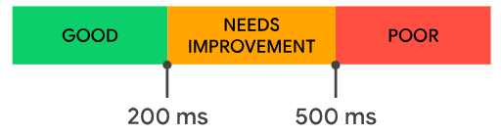
Core Web Vitals
Visual Load → Largest Contentful Paint (LCP)
Visual Stability → Cumulative Layout Shift (CLS)
Interactivity → Interaction to Next paint (INP)
Focuses on loading, interactivity, and visual stability

Slide 36
Largest Contentful Paint - LCP
Visual Load
“Largest Contentful Paint is a performance metric that measures the loading time of the main content of a web page.”
how long it takes from the user initiating the page load until the largest text block, image, or video is rendered within the viewport.
LCP must occur within 2.5 seconds of when the page first starts loading.

Slide 37
What does LCP measure?
Images
Video poster images
Background images
Block-level text
The LCP element size usually reflects what's visible in the viewport.
For resized images, the reported size is the smaller of the visible size or the intrinsic size.

Slide 38
What Causes LCP
Blocked Caching
Slow Hosting
Render-Blocking Javascript or CSS
Un Optimized Images

Slide 39
Interaction to next pain
interactivity
“INP (Interaction to Next Paint): Measures a page's overall responsiveness to user interactions by observing the latency of all click, tap, and keyboard interactions that occur throughout the lifespan of a user's visit to a page.”
The final INP value is the longest interaction observed, ignoring outliers.
The page's INP is calculated when the user leaves the page.
A low INP means that a page was reliably responsive to user input.
25% of visitors will leave a website if it takes more than 4 seconds to respond.
pages must have a INP of 200 milliseconds or less.

Slide 40
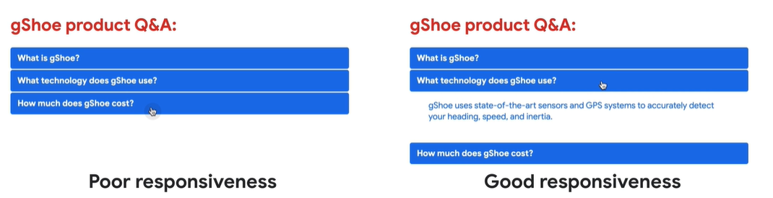
Inp…cont. example

Slide 41
Cumulative Layout Shift (CLS)
visual stability
“Cumulative Layout Shift, is a metric that measures the stability of content on a webpage. It quantifies how often and how significantly elements on the page shift positions unexpectedly from the user’s viewpoint during the loading phase.”
To provide a good user experience, must should maintain a CLS of 0.1. or less.

Slide 42
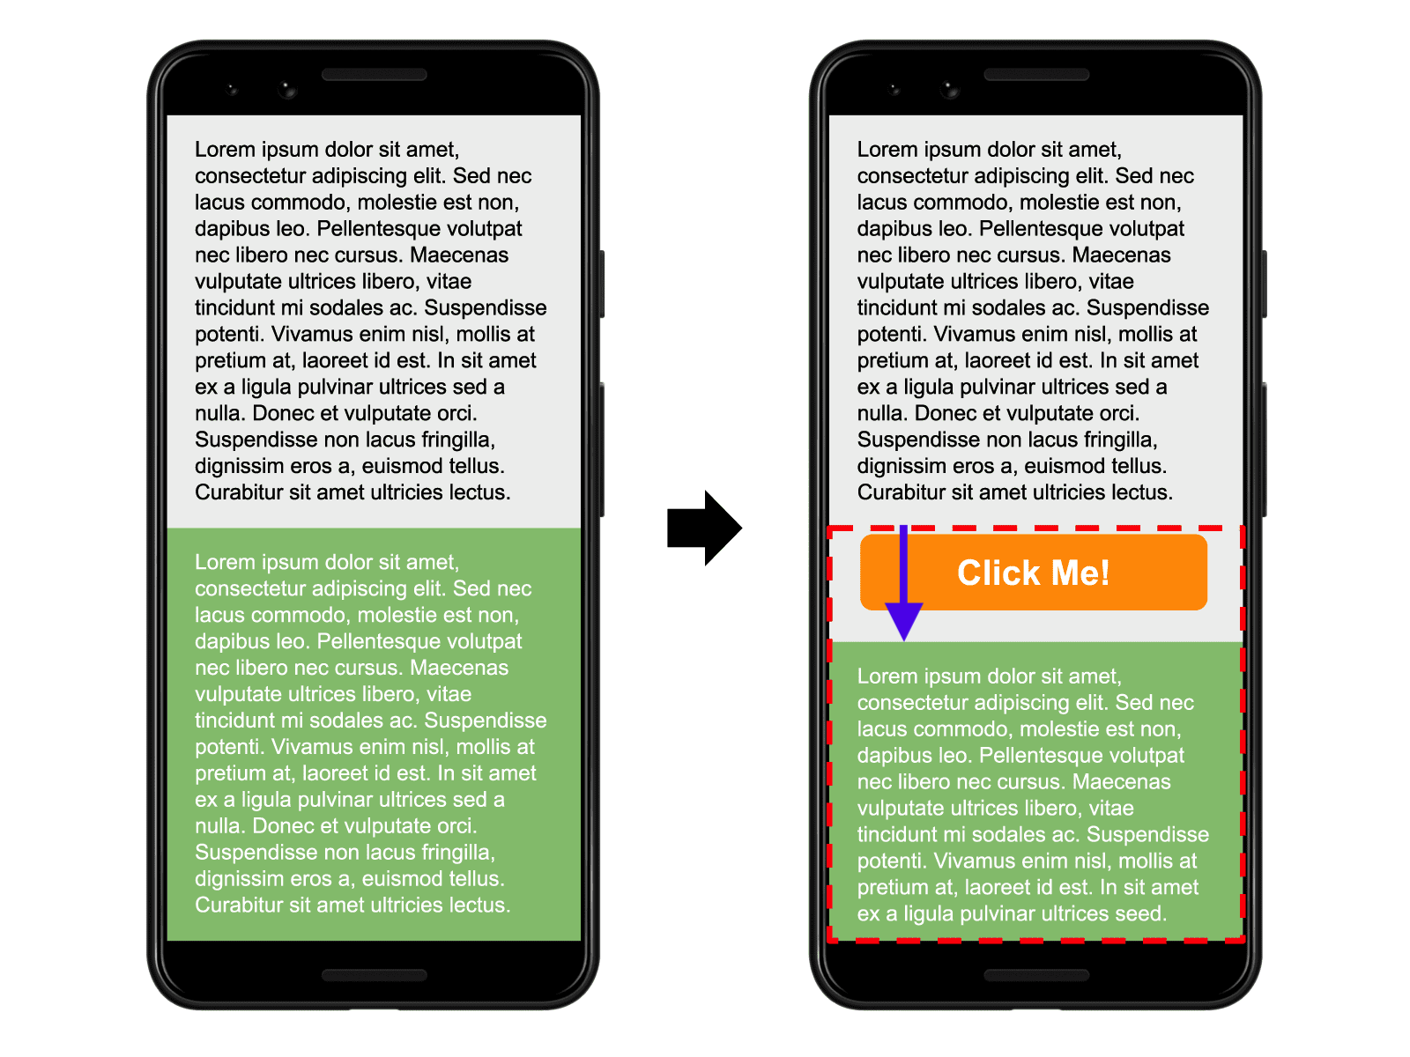
Cumulative Layout Shift (CLS)…cont.
Not all layout shifts are bad. Dynamic web applications often change element positions. A layout shift is problematic only if unexpected.
Shifts due to user interactions (like clicking, tapping, or typing) are usually fine.
Example: Elements in the visible viewport shift from their starting position while a user is reading content on a given page.

Slide 43
How to improve page speed
Here are few ideas for improving your website speed:
Compress your images:
Images are usually the biggest files on a webpage.
Use image compression tools to reduce their file sizes so they take as little time to load as possible.
Use a content distribution network (CDN):
A CDN stores copies of your webpages on servers around the globe. It then connects visitors to the nearest server, so there’s less distance for the requested files to travel.
Minify HTML, CSS, and JavaScript files:
Minification removes unnecessary characters and whitespace from code to reduce file sizes. Which improves page load time.

Slide 44
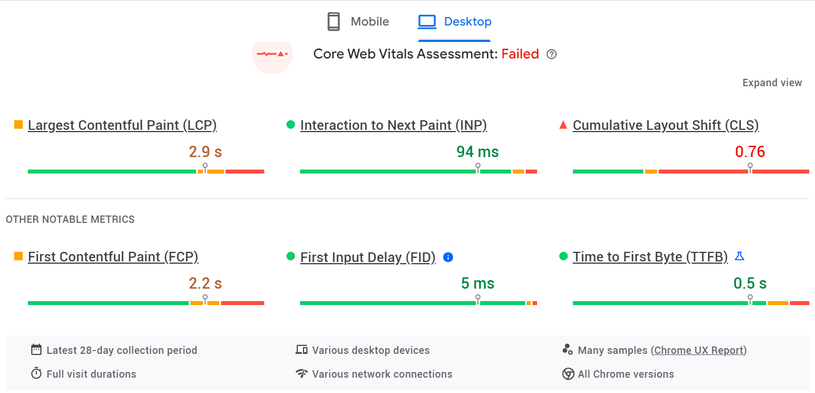
Sample LCP Test (numl.edu.pk)

Slide 45
